Slide 1
Personalized Evaluation & Education through Gamified Learning
INFT 44
Abhishek Bhave 14101B0045
Project Guide: Prof Deepali Nayak Kedar Mane 13118C0066
Mayank Mirani 14101B0028

Slide 2
Introduction
Over several years there has been extensive research in improving the way knowledge is conveyed in an efficient manner.
A combination of visual responsiveness, analytical skills can be captured through a game based environment. Game based learning has seen an increase in market adoption over the years.
The market growth of gamified learning is expected to grow exponentially from $1,707 billion in 2015 to $5,500 billion in 2018.
Most of the developed countries such as North America and Europe are widely using this strategy of e-learning whereas the developing economies such as India and China are huge markets with untapped potential.
Revenue for organizations selling game based learning and simulation products will increase by at least 23% by 2018.

Slide 3
Problem Statement
Data in educational sector is readily available but there has not been enough analysis done on that available data. There is a dearth of student teacher interaction and motivation for learning and improving student teacher interaction and thereby introducing new teaching methodologies and ideas.
Learning experience and personalized learning is the future of education.
There has been a failure to integrate data mining analytics with gamification in learning. Many projects have failed to achieve common integration in gamification with data mining.
All existing educational data mining applications and systems are rudimentary in nature and fail to achieve appropriate evaluation and gamification.

Slide 4
Abstract
Gamified learning is an educational approach to motivate students to learn by using game design and game elements in learning environments and to maximize engagement through capturing the interest of learners and inspire them to continue learning.
Gaming is a popular pastime and according to a recent Times of India article 40% of Indian teenagers tend to play for more than 6 hours per week. Currently, less than 10 % of Indian corporates use gamification actively and fewer than 3 % education institutes make use of gamification.
Educational data mining[EDM] is one of the solutions to improving learning and grasping power of students on a broader scale rather than being confined to an individual students level.
Analysis on learners behavior, cognitive learning and level of fundamental knowledge acquired are some of the major analysis done on E-learning data.
This project aims to create a game for students which they will play and thus faculty get the appropriate data about students skill, weak and strong areas, so as to personalize learning for every student and to improve learning experience.

Slide 5
Project Objective:
To improve learning and motivation to students through fun games/ game-based environment and interactive sessions.
To create an innovative teaching- learning methodology with feedback system for courses that can benefit educational system
For overall analysis of student potential on a concept.
To streamline manual data generated in the educational sector and apply data mining algorithms to recognize patterns.

Slide 6
Scope
1. Data Analysis
This project aims to do clustering of data that is generated from gamification. As a result of clustering, we hope to establish clusters to evaluate performance of students on the game.
2. Evaluation
One of the goals of this project is to evaluate the standard or skills of a student with the use of gamification. Here the student is asked to complete a game depending on the course that is taught and on the basis of that clustering is done.
3. Recommendation
In this system, once the clustering of students is done according to the score of the game, recommendation will be given to the students as per their score.

Slide 7
Literature Survey
Sr. No | IEEE Paper | Observations/ Advancements | Challenges
1. | Applying Gamification and Social Network Techniques to Promote Health Activities | The interactive elements in games have already been shown to be a motivating factor for strengthening the participation of the individual in Internet activities | This IEEE paper was not able to display results using human system interaction and hence needed personalized interactive model.
2. | Gamiﬁcation of Software Testing | With gamiﬁcation, developers can be engaged into testing activities. Finally, by turning software testing into games with a purpose, we can solve complex testing problems using human intelligence. | Developing new game concepts around software testing and integrating them into teaching, practice, and crowdsourcing proved to be very difficult.
3. | Gamification strategies for Mobile Device Applications | Gamification aims to give bonuses to the user for each task performed, keeping the interest in achieving more points and getting to next phase in other elements, as in levels, leadership table, among others. Gamification is an effort to promote fun and entertainment, thus resulting in acceptance by application users. | Absence of evaluation in most applications shows the lack of evidence on effects of gamification elements implied in the study. To make users more engaged and motivated while interacting with gamified applications was not easy as the users lost their will to play the game repeatedly.

Slide 8
4. | The Evaluation Study of Gamification Approach in Malaysian History Learning via Mobile Game Application | Enhance a student’s learning experience. High user engagement Simple gameplay using touch inputs | Poor UI Increases student learning but fails to provide results to teachers
5. | Work in Progress: Towards a Generic Platform for Implementing Gamified Learning Arrangements in Engineering Education | Uses Domain Specific Modelling (DSM)Approach as compared to existing gamification projects | Though DSM approach is innovative way it is yet to be practically implemented
6. | Introducing Gamification into e-Learning University Courses | Use of the elements of gamification can be a meaningful way to increase student motivation and improve the educational effectiveness of online courses. Gamification places greater emphasis on student motivation in the learning process and increases students’ willingness to learn and their engagement with course materials. An online course which is designed with the application of elements of computer games will have a greater effect on the amount of use of online teaching materials in comparison with a course with the same educational content, but without the presence of elements of computer games. | Conducting the experiment was planned at a time when Students did not have a mid-term or final exam. Analysis should be carried out in a short time-period during the two to three weeks after the students had gained access to learning materials.

Slide 9
7. | Personalized Gaming: A Motivation and Overview of Literature | Games that utilized player models for the purpose of tailoring the game experience to the individual player. This paper was a motivation for personalized gaming, supported by an extensive overview of scientific literature. | Combination of personalization techniques, and in its incorporation into a game’s design. Game design is expected to develop into an increasingly less predetermined direction.
8. | Raising engagement in e-learning through gamification. | Gamification does not imply creating a game. It means makes education more fun and engaging, without undermining its credibility. Gamification helps students gain motivation towards studying, and because of the positive feedback they get pushed forwards and become more interested and stimulated to learn. Gamification can constitute a powerful boost to determine them to study/read more. | To improve the metrics in Gamification world which are:- page views per visitor, time spent on site, total time per user, frequency of visit, participation and conversions.

Slide 10
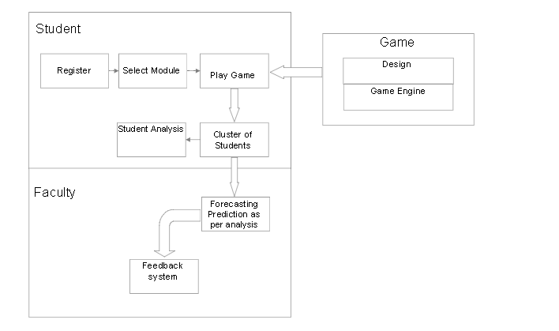
Proposed System
BLOCK DIAGRAM

Slide 11
Technologies Used
Gamification Project is be a Web Based application.
Visual Studio 2013 and SQL server 2014 are used for creating the interface and for databases respectively.
Amazon web services is used to host our project as they offer hosting at miniscule costs and also offer wide variety of features like servers and database support.

Slide 12
Process Model - Prototype Model
Prototype model is very desirable when lot of end user interfacing is required. Workable prototype is ready much earlier and user feedback can be taken to improve project software.
Iterative approach to be used for implementation of project.
Iteration 1 -Data Collection using Gamification
Iteration 2- Data preprocessing and Analysis
Iteration 3 - Faculty Feedback system after prediction and forecasting

Slide 13
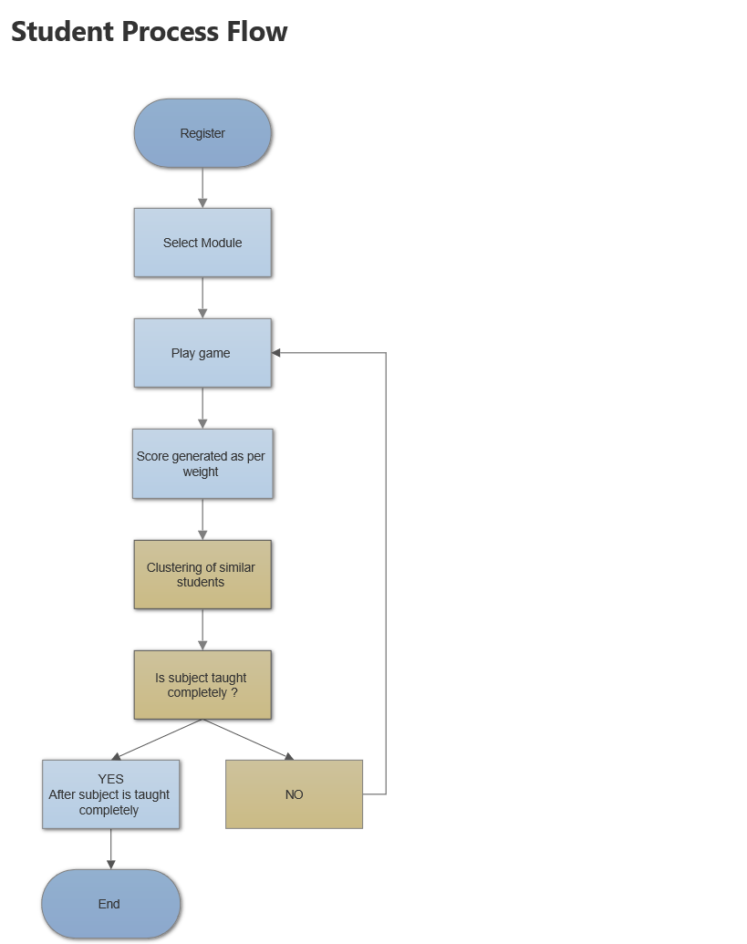
Student Process Flow Diagram

Slide 14
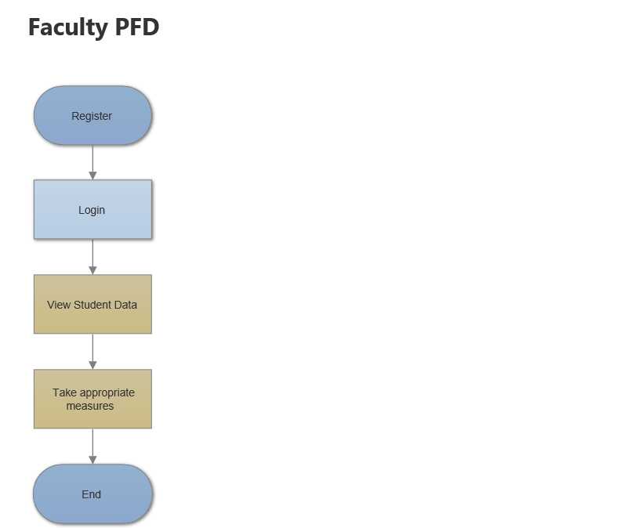
Process Flow Diagram for Faculty

Slide 15
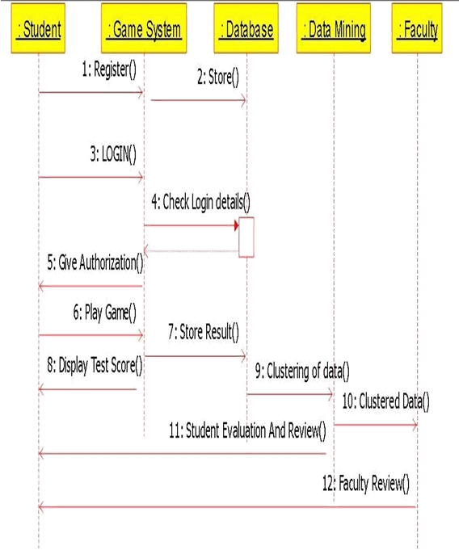
Sequence Diagram

Slide 16
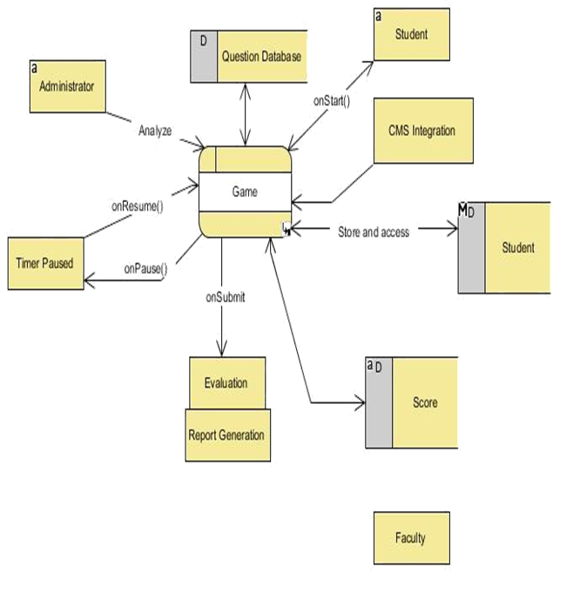
Game Process Data Flow Diagram Level 2

Slide 17
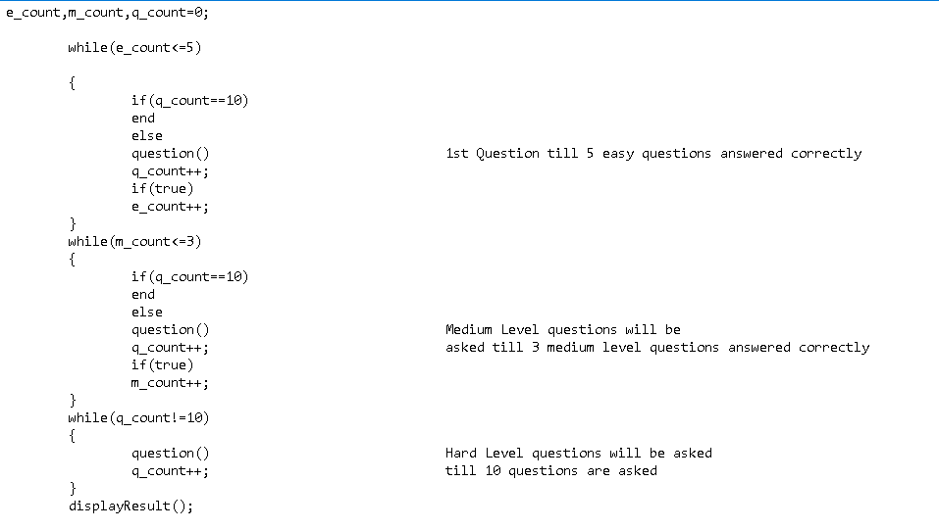
Approach
We are having questions in our game which are adaptive in nature ,that is of increasing difficulty. Below is the adaptiveness pseudo code :

Slide 18
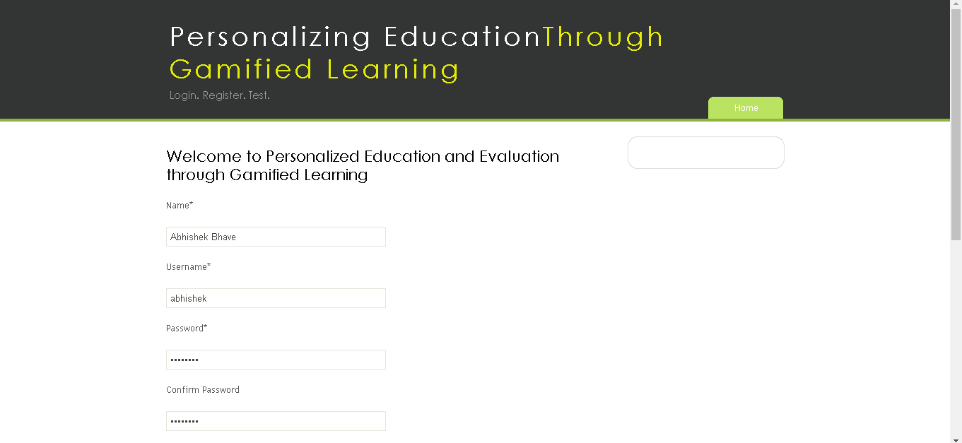
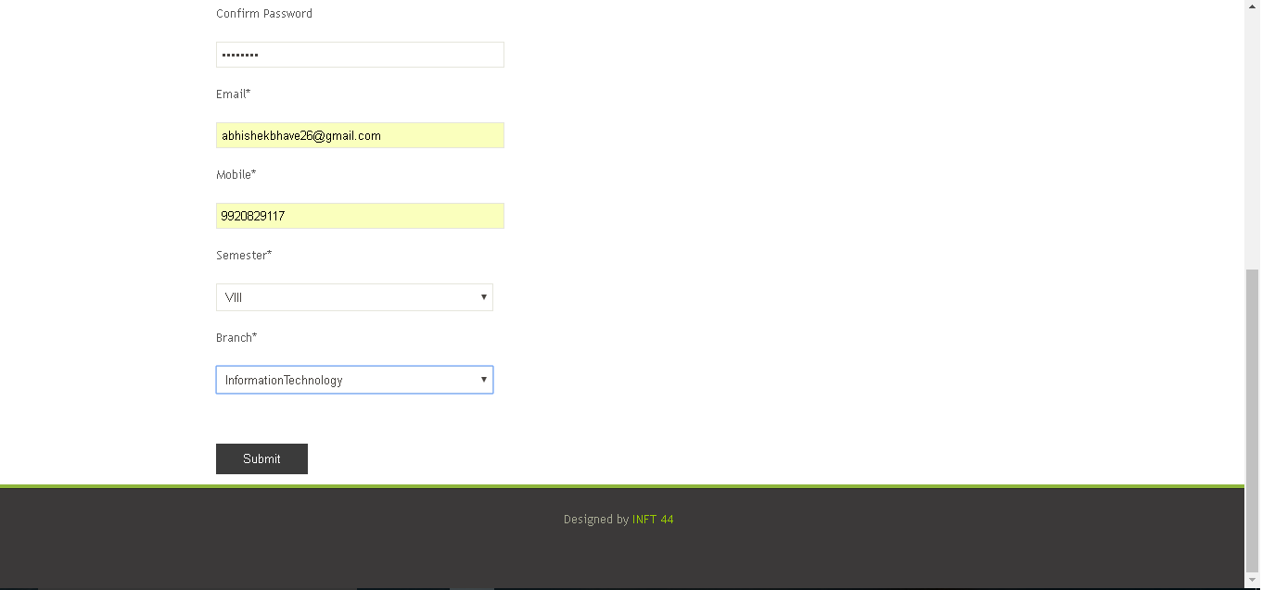
Implementation
The image shows the registration page of the system. Here, user has to enter all details asked in the registration form. The details will be later used in the login process. All text ﬁelds are validated to ensure that valid details are provided.

Slide 19
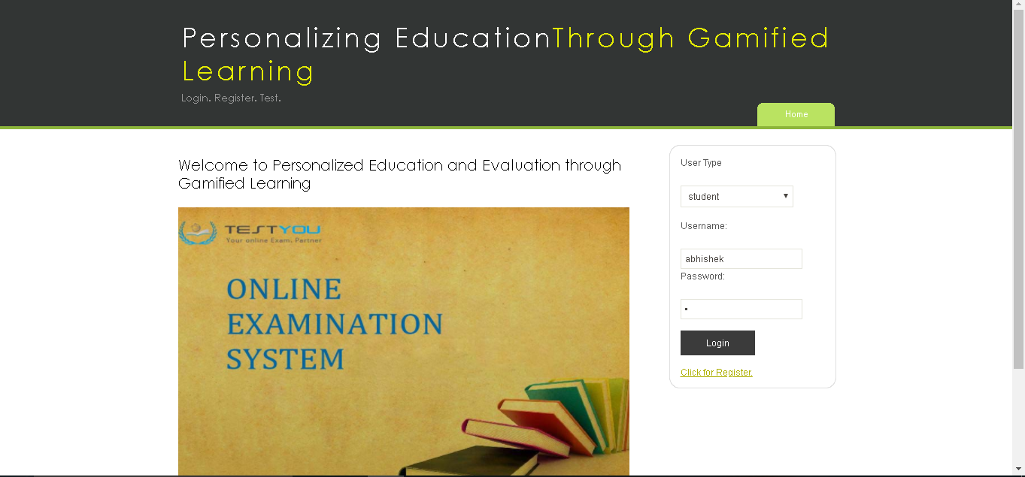
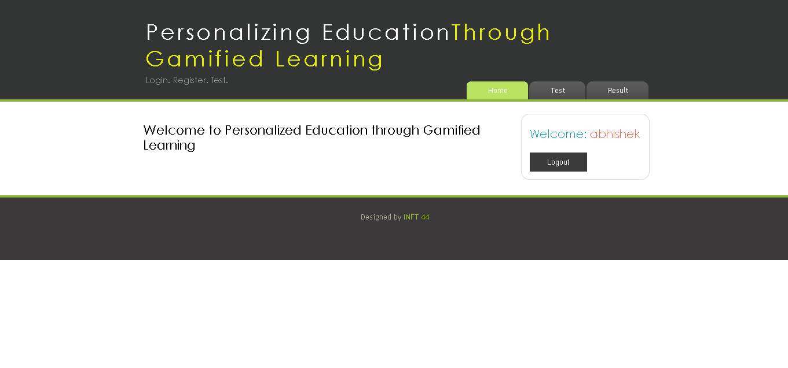
The user logs in he will be greeted with the above homepage.

Slide 20
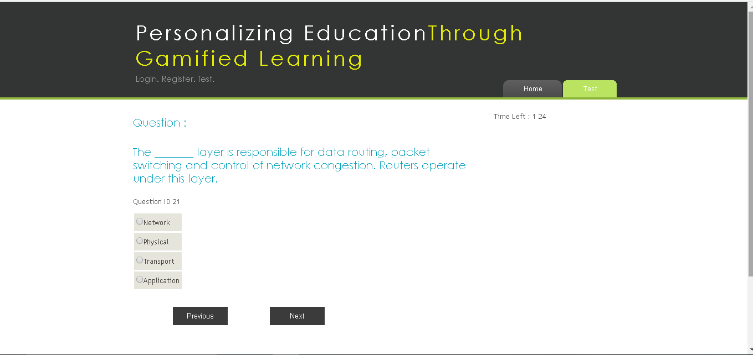
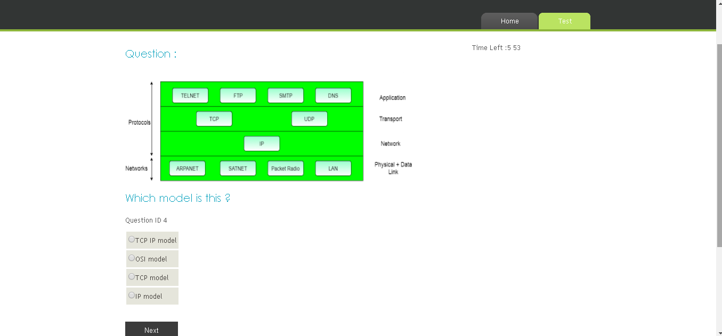
The page is loaded and the timer starts with the 1st question being displayed. The student answers the question and clicks on the next button. The next question is displayed and so on till the last question.

Slide 21
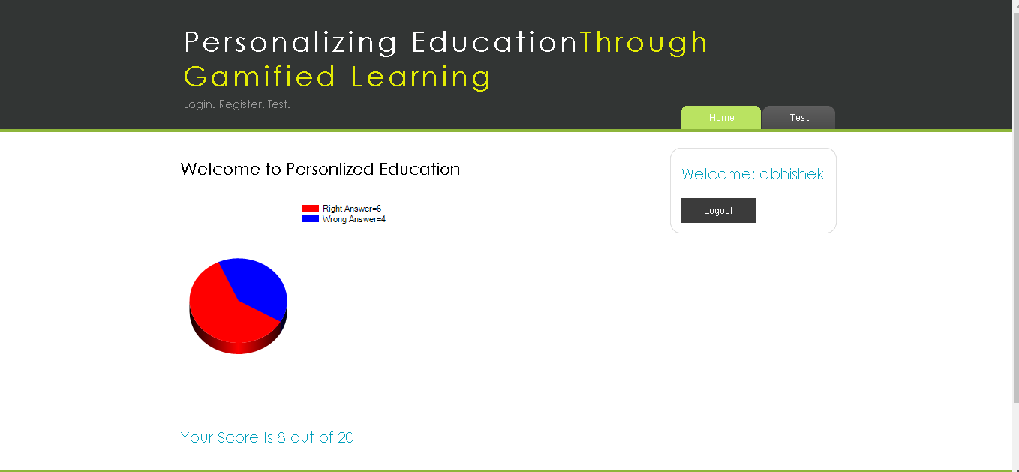
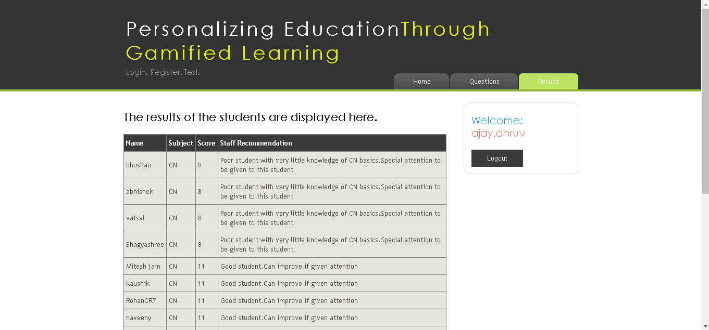
The following image show the result generated page which shows the result of the test in a pie chart or graphical representation.
The following image shows the Result page which shows the tabular representation of the 3 clusters in which the student lies. As per the cluster the automated staﬀ recommendation is presented and the staﬀ/faculty will know the knowledge of each student.

Slide 22
Timeline :-

Slide 23
THANK YOU

